Slide 1
STAT 6371: FINAL REVIEW

Slide 2
Exam Logistics
Saturday, August 10th : 11am to 2pm CST
Delivered on Word Doc (Same as Midterm)
Submit to Canvas
Put answers on Word Doc
Only rule is to not speak to anyone about the test from 11am to 2pm CST and you cannot copy and paste any responses from anywhere. All responses must be in your own words and written / typed by you.
You can use HW Solutions
Asynch Videos
FLS Solutions
The Book
The internet
You can use ChapGPT
Just no other human that can help (except Bivin)
IMPORTANT: There is not time budgeted to use these resources so you should study for this exam as if it is closed book. There will not be enough time time to use these resources to answer questions unless the student knows right where to go and the resource is a reminder of what they already know.
You may go to the restroom, answer the door, etc. at any time without asking.

Slide 3
Topics
Know about experimental design: Randomized Experiment v. Observational Study.
Know The Definition of Type 1 and Type 2 Error and Power.
Be able to find and interpret confidence intervals and how they are related to hypothesis tests and p-values.
Know the 1 and 2 sample T-Tests. Be able to perform a complete analysis: State the Problem, Address the Assumptions, Run the Test, clearly state the conclusion / results.
Know how to perform a complete analysis with non-parametric tests. Rank-Sum, Sign-Test, Signed Rank, Etc.
Know Multiple Comparison Methods: Bonferroni, Tukey-Kramer, Dunnett’s
Be very familiar with running an ANOVA and interpreting the results. (KRUSKAL-WALLIS AS WELL.)
Know Simple and Multiple Linear Regression
Know how to interpret coefficients: both continuous and categorical and interactions.
Know how to interpret coefficients after a log – log, linear log or log linear model.
Know how to find and interpret confidence and prediction intervals.
Know about Assumptions, Residuals, Checking for Influential Points. (Leverage, studentized residuals, Cook’s D, etc.)
Know about confounding and how to account for particular potential confounding variables.
Know how and why to perform an Extra Sum of Squares Test
Know how and why to perform a lack of fit test.
Know what forward selection, backward elimination and stepwise selection are and be able to select a model through using any of those methods.
There will be a question on the exam that asks you to use ChatGPT3.
BONUS: Know how to find confidence intervals / standard errors for linear combinations of parameter estimates.

Slide 4
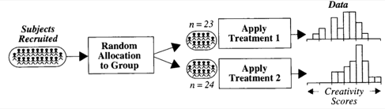
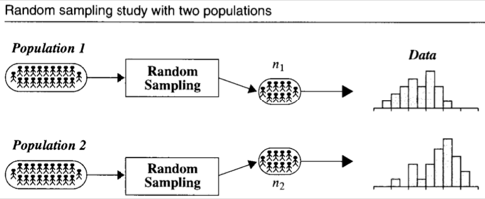
Types of Studies
Creativity Study
Salary Study
Randomized Experiment
Observational Study

Slide 5
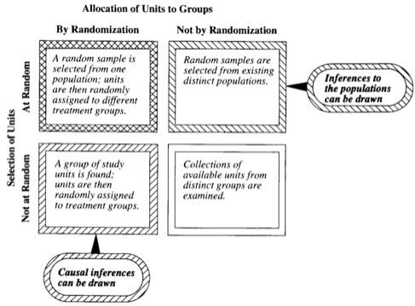
Cause and Effect vs. Inference to Larger Population

Slide 6
1 Sample T- Test!
Assumptions:
Data Are Normally Distributed.
Observations are Independent of One Another
What it Tests:
Means

Slide 7
2 Sample T- Test!
Assumptions:
Both Populations Are Normally Distributed
Both Populations have identical Standard Deviations
Observations are Independent of One Another
Notes: THE Uniformly Most Powerful Test (UMP) when the assumptions are met.
What it Tests:
Differences of Population Means

Slide 8
Robustness of T-Test
T-Tests (T-Tools … Tests and Confidence Intervals) are Robust to departures from normality.
3 Cases Emerge:
If sample sizes are sufficiently large and are the same, the t-test is robust to departures from normality and differences in variance (sd).
If sample sizes are sufficiently large and the standard deviations are the same, the t-tests are robust to departures from normality and different sample size.
If the sample sizes are different (even if they are large) and the variances / standard deviations are different, alternatives to the pure t-test are suggested.

Slide 9
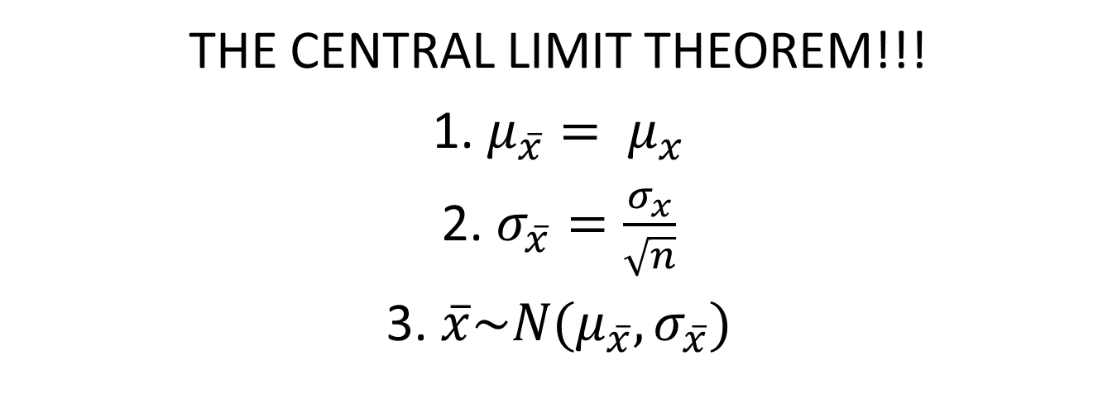
Holy Grail for the Robustness of the T-Test
THE CENTRAL LIMIT THEOREM!!!
1. $μ_{\overline{x}}= μ_{x}$
2. $σ_{\overline{x}}=\frac{σ_{x}}{\sqrt{n}}$
3. $\overline{x}\sim N(μ_{\overline{x}},σ_{\overline{x}})$
Computer Simulation for Sufficient Sample Size.

Slide 10

Notes about the F-Test for Equal Variance
Ho: population variances are equal
Ha: population variances are not equal
Assumption:
The two Populations are Normally Distributed
USE AS SECONDARY / SUPPORT EVIDENCE AFTER A VISUAL CHECK OF THE HISTOGRAM, BOX PLOT and Q-Q PLOT. A Great alternative is the Brown-Forsythe Test … it has fewer assumptions.

Slide 11
Tests for Paired Data

Slide 12
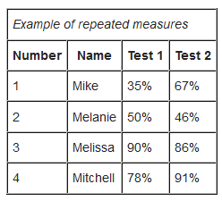
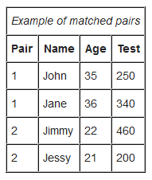
Paired (aka Matched Pairs or Dependent) T-Test
Assumptions
Data are either:
from one sample that has been tested twice (example pre- and post-test / repeated measures)
Or from a group of subjects that are thought to be similar and can thus be matched or paired (example from same family, or twins)
Differences are normally distributed.
Notes: Not Resistant to Outliers.
What it tests: Mean Difference is Different than 0.

Slide 13
Sign Test
Assumptions:
Data are able to be paired.
Differences are independent.
Data is ordinal.
Notes:
1. Not a very powerful test but easy and quick.
2. Resistant to Outliers
What is tests: Tests if the Median Difference is different than 0.

Slide 14
Signed Rank Test
Assumptions:
Data are able to be paired.
Differences are independent.
Data is ordinal.
Notes:
1. More powerful than the Sign Test since it uses more information (the ranks).
2. Resistant to Outliers
What is tests: Tests if the Median Difference is different than 0.

Slide 15
Let’s Practice With Some Scenarios!

Slide 16
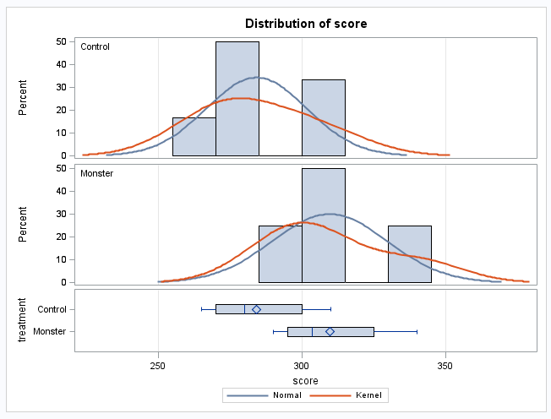
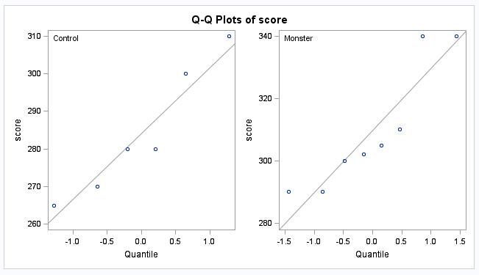
Dataset 1: Monster Drink Study
Monster 300
Monster 310
Monster 290
Monster 305
Monster 302
Monster 290
Monster 340
Monster 340
Control 280
Control 310
Control 270
Control 280
Control 265
Control 300

Slide 17
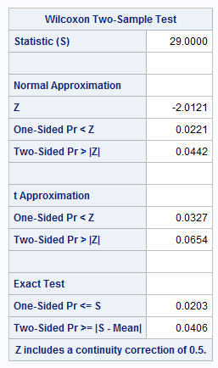
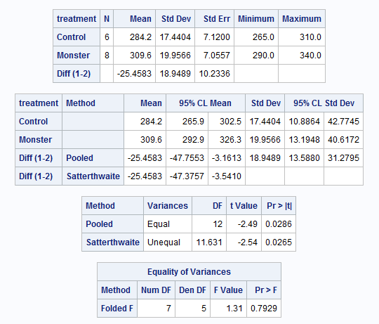
Which Test?

Slide 18
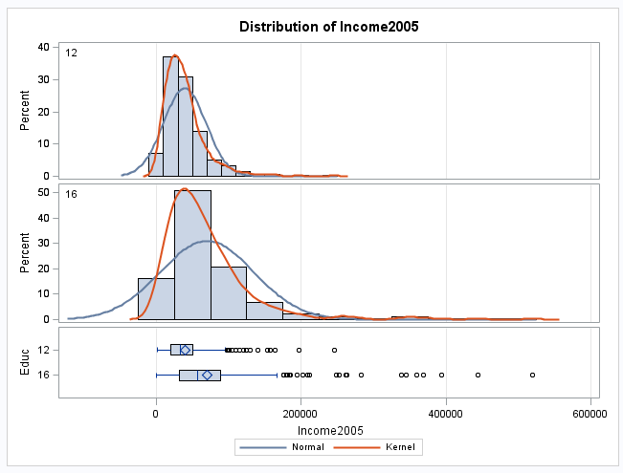
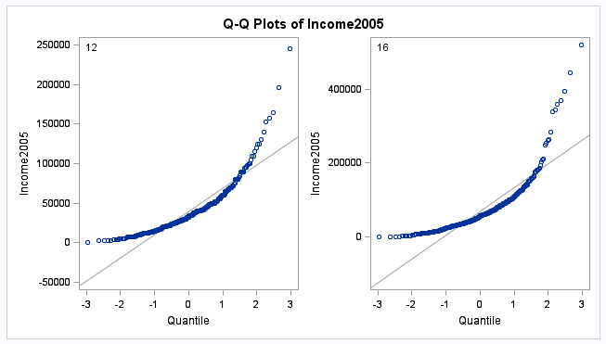

Dataset 2: Education Data from HW2
?
?

Slide 19
Topics
Know The Definition of Type 1 and Type 2 Error and Power.
Be able to find and interpret confidence interval and how they are related to hypothesis tests and p-values.
Know the 1 and 2 sample T-Tests. Be able to perform a complete analysis: State the Problem, Address the Assumptions, Run the Test, clearly state the conclusion / results.
Know how to perform a complete analysis of with non-parametric tests. Rank-Sum, Sign-Test, Signed Rank, Etc.
Remember Multiple Comparison Methods.
Remember ANOVA
Extra Sum of Squares F –Test (Partial F-Test)
Know Simple and Multiple Linear Regression
Know how to interpret coefficients.
Know how to create models.
Know about Assumptions, Residuals, Checking for Influential Points.
Know about confounding and how to account for particular potential confounding variables.
Know about experimental design: Randomized Experiment v. Observational Study.

Slide 20
Chapters 5 and 6!!!
1 WAY ANOVA
BROWN FORSYTHE TEST
KRUSKAL-WALLIS
CONTRASTS
MULTIPLE COMPARISONS

Slide 21
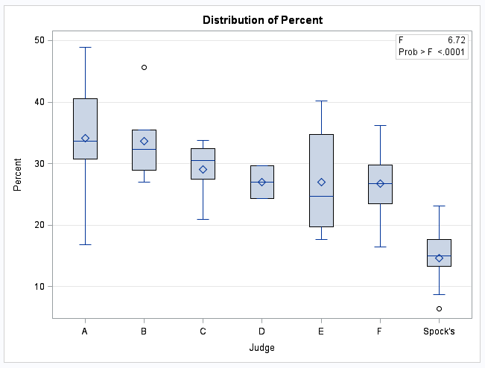
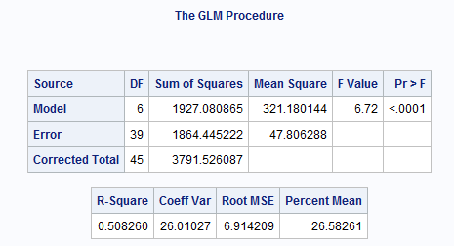

1 Way ANOVA
Ho: All means are equal (Spock and Others)
Ha: At least 2 are different (Spock and Others)

Slide 22
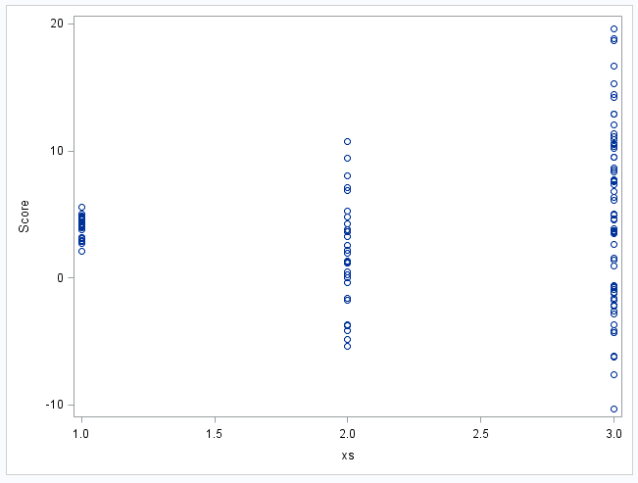
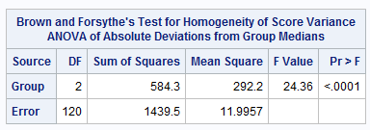
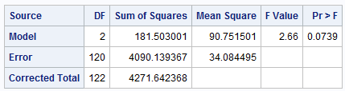
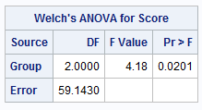
Assumptions and Analysis:
There is strong evidence in support of these data coming from distributions with different standard deviations. We will proceed under this assumption and run the Welch’s ANOVA.
There is sufficient evidence at the alpha = .05 level of significance (p-value .0201 from Welch’s ANOVA) to suggest that at least two of the means are different.

Slide 23
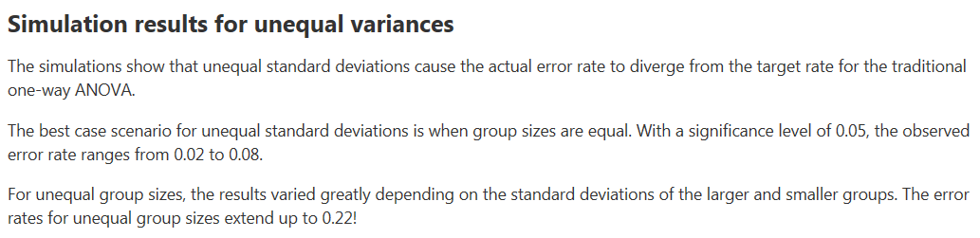
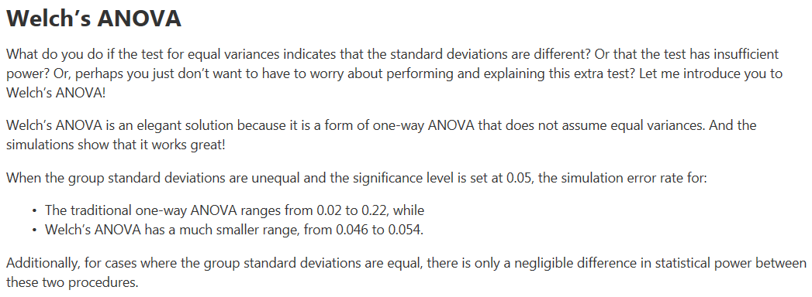
Performance of Welch’s Test

Slide 24
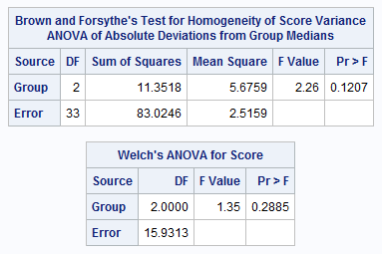
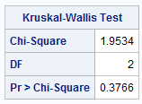
Kruskal-Wallis Test
There is not sufficient evidence at the alpha = .05 level of significance (p-value .3766 from Kruskal-Wallis Test) to suggest that at least two of the medians are different.
Notice that each test failed to reject their respective Ho. The point isn’t so much that one test will reject when the other will fail to reject. We must remember that as statisticians we don’t personally favor one outcome over the other. We just want the appropriate test: the one with the most power, and the point is that the Kruskal-Wallis Test is the appropriate test.

Slide 25
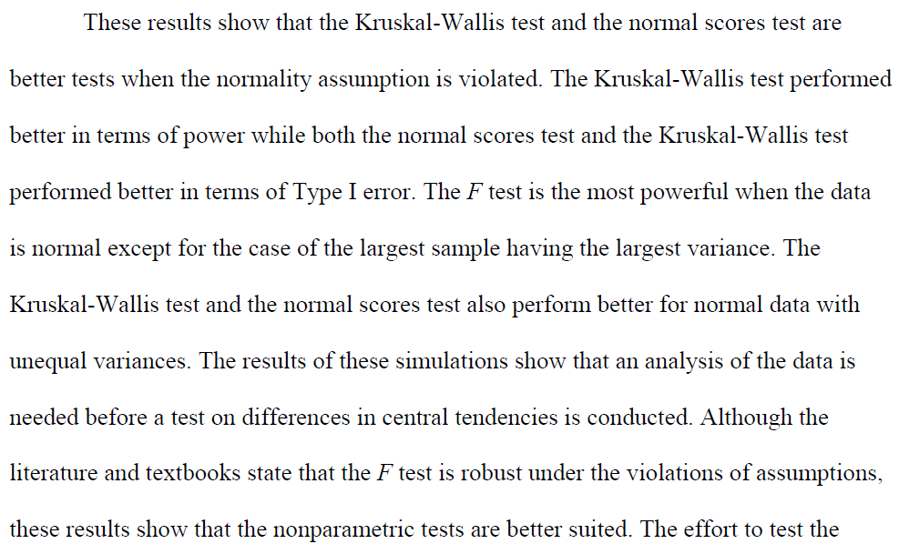
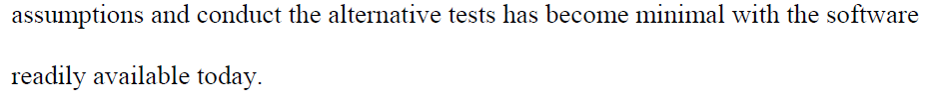
Kruskal-Wallis: Simulation Study
http://etd.fcla.edu/WF/WFE0000158/Patrick_Joshua_Daniel_200905_MS.pdf

Slide 26
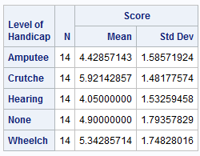
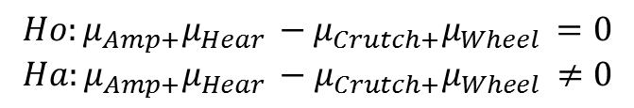
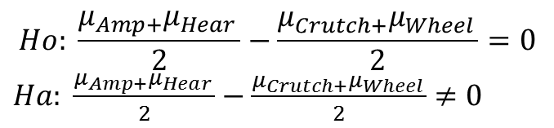

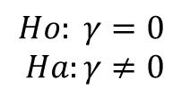
FIRST QOI: Is the mean of Amputee/Hearing different than the mean of Wheelchair/Crutches
$$Ho: \frac{μ_{Amp+}μ_{Hear }}{2}=\frac{μ_{Crutch+}μ_{Wheel }}{2}$$
$$Ha: \frac{μ_{Amp+}μ_{Hear }}{2}≠\frac{μ_{Crutch+}μ_{Wheel }}{2}$$
$$Ho: \frac{μ_{Amp+}μ_{Hear }}{2}−\frac{μ_{Crutch+}μ_{Wheel }}{2}=0$$
$Ha: \frac{μ_{Amp+}μ_{Hear }}{2}−\frac{μ_{Crutch+}μ_{Wheel }}{2}$ $≠0$
$$Ho:{μ_{Amp+}μ_{Hear }−μ}_{Crutch+}μ_{Wheel }=0$$
$$Ha:{μ_{Amp+}μ_{Hear }−μ}_{Crutch+}μ_{Wheel }≠0$$
Contrast →
$γ=1μ_{amp }−1μ_{Crutch }$ $+1μ_{Hear }$ $+0μ_{None }−1μ_{Wheel}$
$$Ho: γ=0$$
$$Ha:γ≠0$$

Slide 27
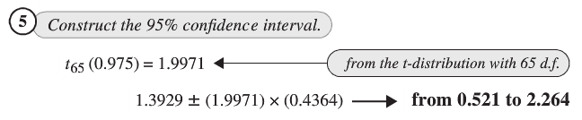


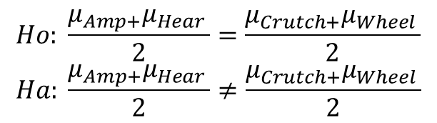
Chapter 6
$$Ho: \frac{μ_{Amp+}μ_{Hear }}{2}=\frac{μ_{Crutch+}μ_{Wheel }}{2}$$
$$Ha: \frac{μ_{Amp+}μ_{Hear }}{2}≠\frac{μ_{Crutch+}μ_{Wheel }}{2}$$
$γ=1μ_{Amp}−1μ_{Crutch}$ $+1μ_{Hear}$ $+0μ_{None}−1μ_{Wheel}$

Slide 28

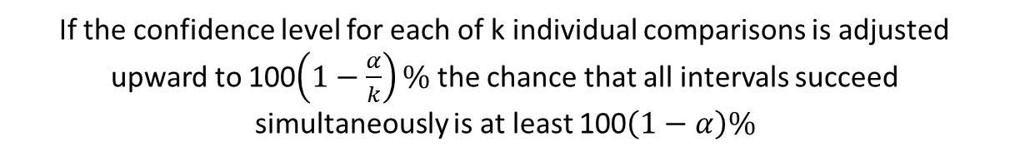
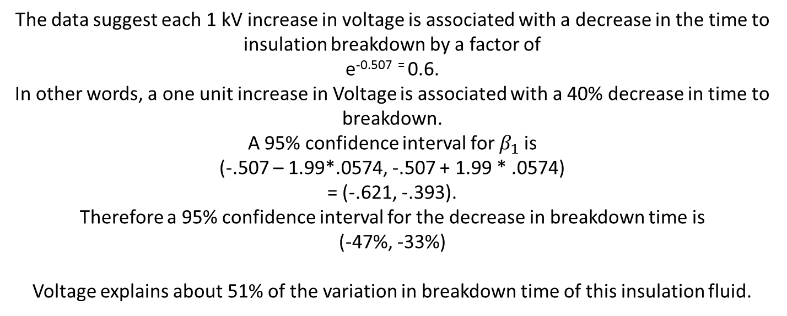
Multiple Comparison: Bonferroni
If the confidence level for each of k individual comparisons is adjusted upward to 100$\left(1−\frac{α}{k}\right)\%$ the chance that all intervals succeed simultaneously is at least 100$\left(1−α\right)\%$
$$multiplier= t_multiplier=t_{\left(1−\frac{α}{2k}\right),df}$$
Very conservative meaning that the intervals are much wider than the nominal level. However, the Bonferroni interval can be used in a wide variety of problems.

Slide 29
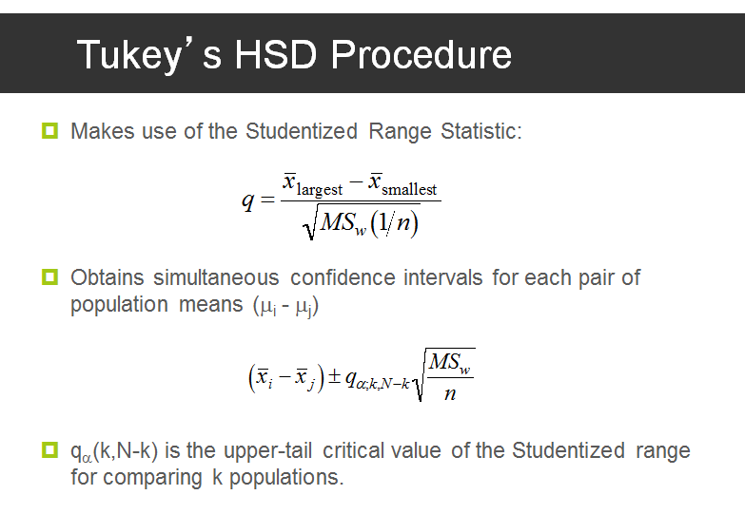

Multiple Comparison: Tukey-Kramer
Studentized Range Statistic Table
Multiplier =
Assumes normal distributions and equal spreads.
More consistent than Bonferroni with respect to Type 1 Error but not robust to its assumptions…. Bonferroni is a good alternative when the assumptions are violated.

Slide 30

Multiple Comparison: Scheffé
Multiplier = $\sqrt{(I−1)F_{\left(I−1\right),df, }(1−α)}$
Scheffé’s multiplier controls the overall confidence level for the family of parameters consisting of all possible linear contrasts among group means. When applied to a smaller subset of differences of pairs of group means, like Bonferroni, it is at least 100(1-alpha)% and generally higher.

Slide 31

Multiple Comparison: Dunnett’s Many Groups to one Control
$$t_{1}=\frac{{\hat{μ}}_{C}−{\hat{μ}}_{1}}{{SE}_{{\hat{μ}}_{C}−{\hat{μ}}_{1}}}$$
$$t_{2}=\frac{{\hat{μ}}_{C}−{\hat{μ}}_{2}}{{SE}_{{\hat{μ}}_{C}−{\hat{μ}}_{2}}}$$
…
$$t_{n}=\frac{{\hat{μ}}_{C}−{\hat{μ}}_{n}}{{SE}_{{\hat{μ}}_{C}−{\hat{μ}}_{n}}}$$
Replaces t-distribution with a multivariate t-distribution to account for the correlation.

Slide 32
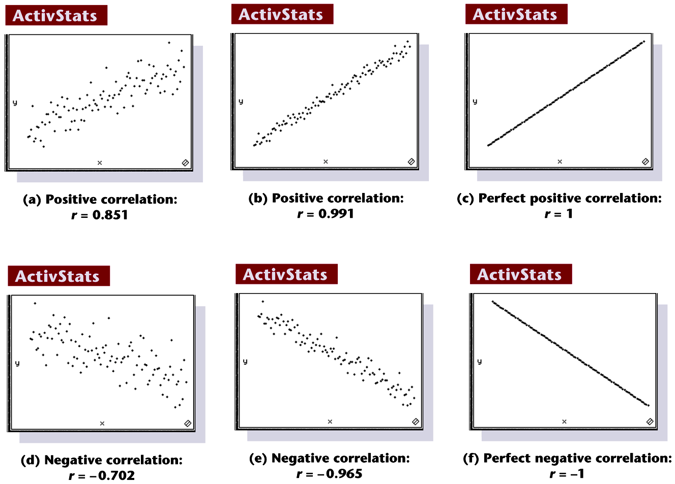
Scatterplots of Paired Data
Notes:
Page 619 of text

Slide 33
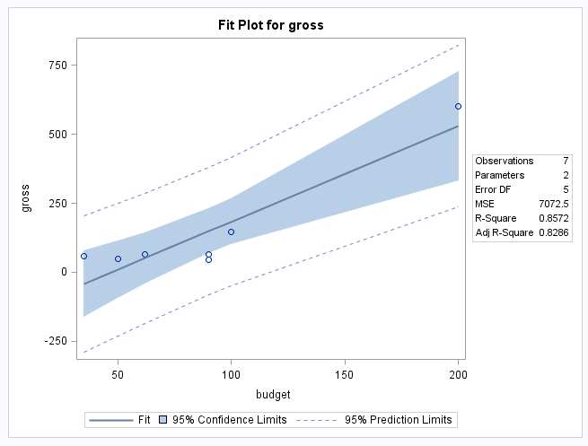

Confidence Intervals
-
Confidence Intervals
Budgets | Est Value | SE Est Value | Lower Lim | Upper Lim
35 | -42.61978 | 46.9740057 | -163.370303 | 78.13074882
65 | 61.542928 | 35.3959431 | -29.4452408 | 152.531096
95 | 165.70563 | 31.9718347 | 83.5194147 | 247.8918499
125 | 269.86834 | 38.9170078 | 169.828984 | 369.9076903
155 | 374.03104 | 52.282405 | 239.722664 | 508.3394195
185 | 478.19375 | 68.3244731 | 302.560097 | 653.8273956
200 | 530.2751 | 76.8670268 | 332.682116 | 727.8680814
We are 95% confident that the mean gross when the budget is $95 million is between $83 and $247 million.
We are 95% confident that the mean gross when the budget is $185 million is between $303 and $654 million.

Slide 34

Prediction Intervals
Prediction Intervals
Budgets | Est Value | SE Est Value | Lower Lim | Upper Lim
35 | -42.61978 | 96.32801 | -290.23881 | 204.9992556
65 | 61.542928 | 91.2436358 | -173.006305 | 296.0921605
95 | 165.70563 | 89.970698 | -65.5714098 | 396.9826744
125 | 269.86834 | 92.6664005 | 31.661771 | 508.0749029
155 | 374.03104 | 99.0071054 | 119.525175 | 628.5369083
185 | 478.19375 | 108.354796 | 199.658875 | 756.7286177
200 | 530.2751 | 113.93449 | 237.397167 | 823.15303
This data suggests that 95% of movies with a budget of $95 million will gross between -$65 million and $396 million.
The predicted gross of a single movie with a budget of $95 million is $165 million. A 95% confidence interval for this estimate is between -$65 to $396 million.

Slide 35
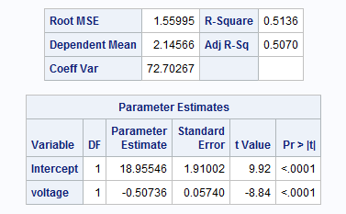
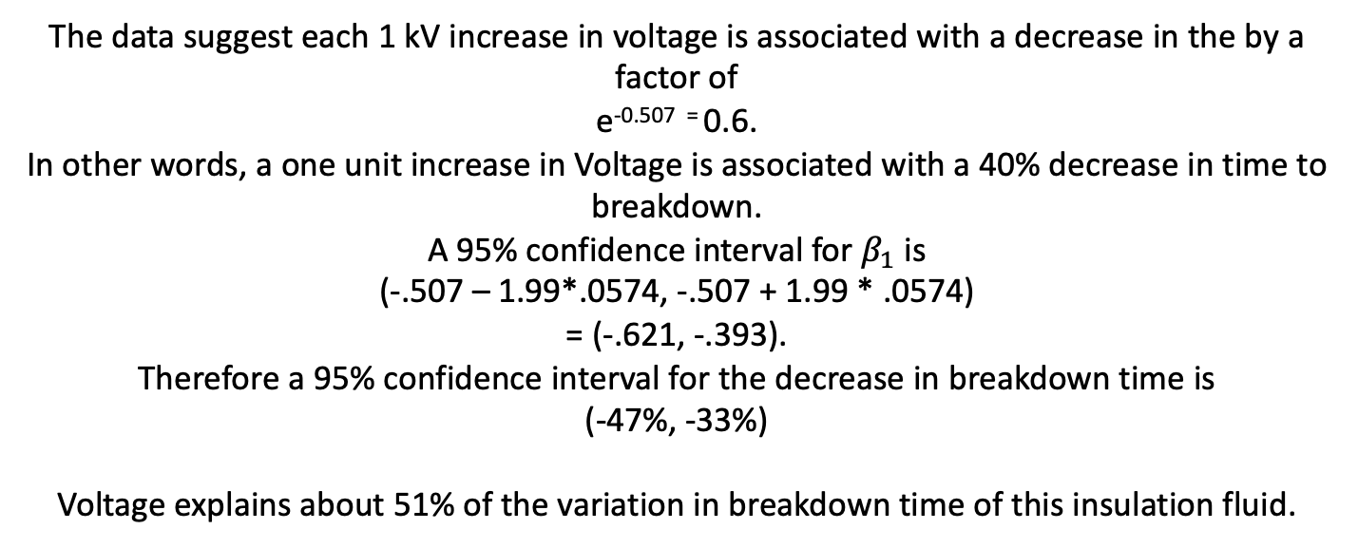
Interpretation: Log – Linear
The data suggest each 1 kV increase in voltage is associated with a decrease in the by a factor of
e^{-0.507 =} 0.6.
In other words, a one unit increase in Voltage is associated with a 40% decrease in time to breakdown.
A 95% confidence interval for $β_{1}$is
(-.507 – 1.99*.0574, -.507 + 1.99 * .0574)
= (-.621, -.393).
Therefore a 95% confidence interval for the decrease in breakdown time is
(-47%, -33%)
Voltage explains about 51% of the variation in breakdown time of this insulation fluid.

Slide 36


Log Transforms: Linear - Log
$$Y=β_{0}+β_{1}Log(X)$$
$$μ\text{\{}\text{Y}\text{|}\text{log}\text{(}\text{X}\text{)\}=}β_{0}+β_{1}Log(X)$$
$μ\text{\{}\text{Y}\text{|}\text{log}\text{(2}\text{X}\text{)}\}−μ\text{\{}\text{Y}\text{|}\text{log}\text{(}\text{X}\text{)}\}=β_{1}$Log(2X) - $β_{1}$Log(X)
$μ\text{\{}\text{Y}\text{|}\text{log}\text{(2}\text{X}\text{)}\}−μ\text{\{}\text{Y}\text{|}\text{log}\text{(}\text{X}\text{)}\}=β_{1}[$Log(2X/X)]
$μ\text{\{}\text{Y}\text{|}\text{log}\text{(2}\text{X}\text{)}\}−μ\text{\{}\text{Y}\text{|}\text{log}\text{(}\text{X}\text{)}\}=β_{1}$Log(2)
A doubling of X results in a $β_{1}$Log(2) unit increase in the mean of Y.
A Confidence Interval Can be easily obtained from Confidence Limits: $β_{1}±t_{\frac{α}{2},df}∗SE(β_{1}$)

Slide 37
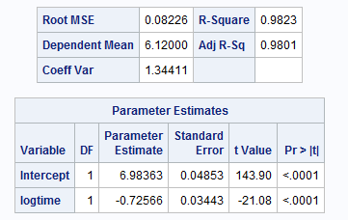
Interpretation: Linear – Log
$$\hat{μ} \text{\{}\text{pH}\text{|}\text{log}\text{(}\text{Time}\text{)\}=}6.984−.7257Log(Time)$$
Interpret the slope:
The response: pH

Slide 38






Further Interpretation: Log-Log
$$μ\text{\{}\text{log}\text{(}\text{Y}\text{)|}\text{log}\text{(}\text{X}\text{)\}=}β_{0}+β_{1}(Log\left(x\right))$$
$$Median\left(Y | X\right)=e^{β_{0}}X^{β_{1}}$$
$$Median\left(Y | 2X\right)=e^{β_{0}}{\left(2X\right)}^{β_{1}}$$
$Median\left(Y | 2X\right)/Median\left(Y | X\right)=e^{β_{0}}{(2X)}^{β_{1}}$/$e^{β_{0}}X^{β_{1}}$
$Median\left(Y | 2X\right)/Median\left(Y | X\right)={(2X)}^{β_{1}}$/$X^{β_{1}}$
$$Median\left(Y | 2X\right)/Median\left(Y | X\right)=2^{β_{1}}$$
Therefore a doubling of X equates to multiplicative change of
$2^{β_{1}}$ for the median of Y given X.

Slide 39
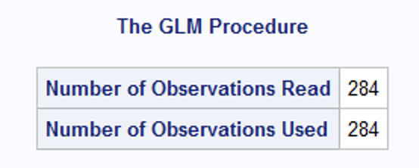
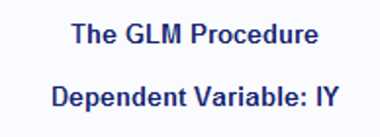
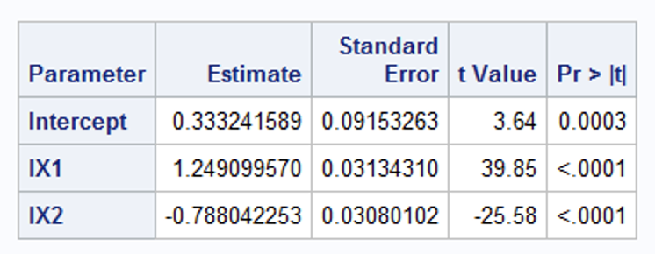

Breakout 1
$$\hat{\log\left(y\right)}= β_{0}+β_{1}log\left(X_{1}\right)+β_{2}log\left(X_{2}\right)$$
Interpret the lX₁ slope (coefficient) and include a 99% confidence interval.

Slide 40
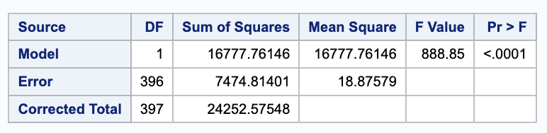
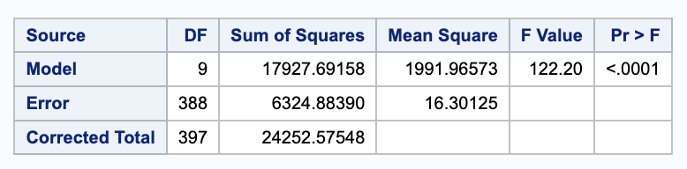
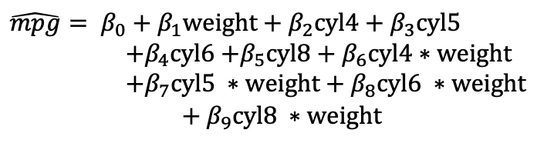

Breakout 2: Extra Sum of Squares Test
We would like to test if there is evidence from an extra sum of squares test to suggest the inclusion of the cylinders term and its interaction with weight. Compare the two models and with an extra sum of squares and defend your choice of models. There were 398 observations.
$\hat{mpg}= β_{0}+β_{1}weight+β_{2}cyl4+β_{3}cyl5$
$+β_{4}cyl6$ $+β_{5}cyl8$ $+ β_{6}cyl4∗weight$
$+β_{7}cyl5 ∗weight$ $+{ β}_{8}cyl6 ∗weight$
$$+{ β}_{9}cyl8 ∗weight$$
$$\hat{mpg}= β_{0}+β_{1}weight$$
Source | DF | Sum of Squares | Mean Square | F Value | Pr > F

Slide 41
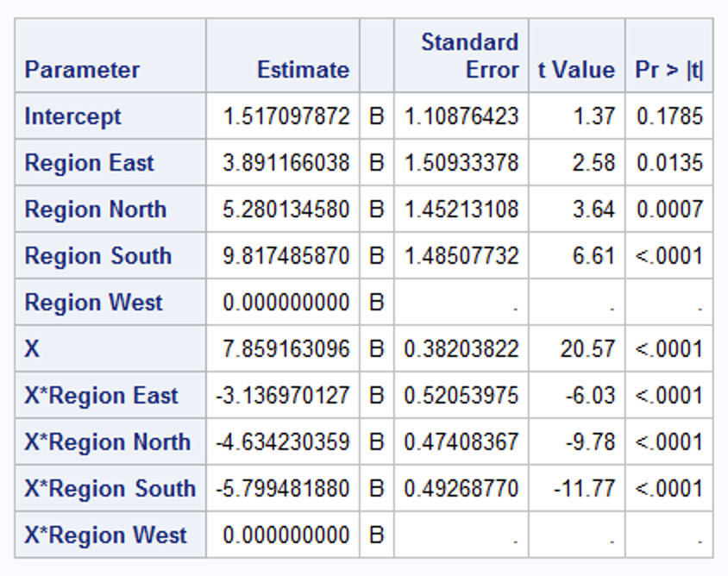
Break Out 3 Categorical Variables and Interactions
n = 10,500
Given the parameter estimate table above, assume all assumption are met. Interpret the Region North and X*Region North parameter estimates Of course, quantify the uncertainty in the inference… that is … provide 95% confidence intervals.

Slide 42
Breakout 4
Main Effect Models (One variable models) |  |  | Two Variable Models |  |  | Three Variable Models
Model 1 Model Variables | P > |t| |  | Model 4 Model Variables | P > |t| |  | Model 7 Model Variables | P > |t|
X | .1 |  | X | .2 |  | X | <.0001
Model 2 Model Variables | P > |t| |  | Y | .03 |  | Y | .13
Y | .02 |  | Model 5 Model Variables | P > |t| |  | Z | .04
Model 3 Model Variables | P > |t| |  | X | .01
Z | .001 |  | Z | .1
 |  |  | Model 6 Model Variables | P > |t|
 |  |  | Y | .02
 |  |  | Z | .03
Conduct a forward selection using the parameter estimate table above. Assume the alpha to enter the model is .15. Simply write down the variables in the final model (2 pts) : ____________
Conduct a backward elimination using the parameter estimate table above. Assume the alpha to exit the model is .05. Simply write down the variables in the final model (2 pts) : __________
Next conduct a stepwise selection using the parameter estimate table above. Assume the alpha to enter and leave the model is .05. Simply write down the variables in the final model (2 pts) : __________

